Slide 1
Review of chapter 6, chapter 7, and chapter 9
https://haokan.baidu.com/v?vid=1031774139509520100&pd=bjh&fr=bjhauthor&type=video

Slide 2

Lecture Presentation
Chapter 6 Electronic Structure of Atoms
James F. Kirby
Quinnipiac University
Hamden, CT

Slide 3
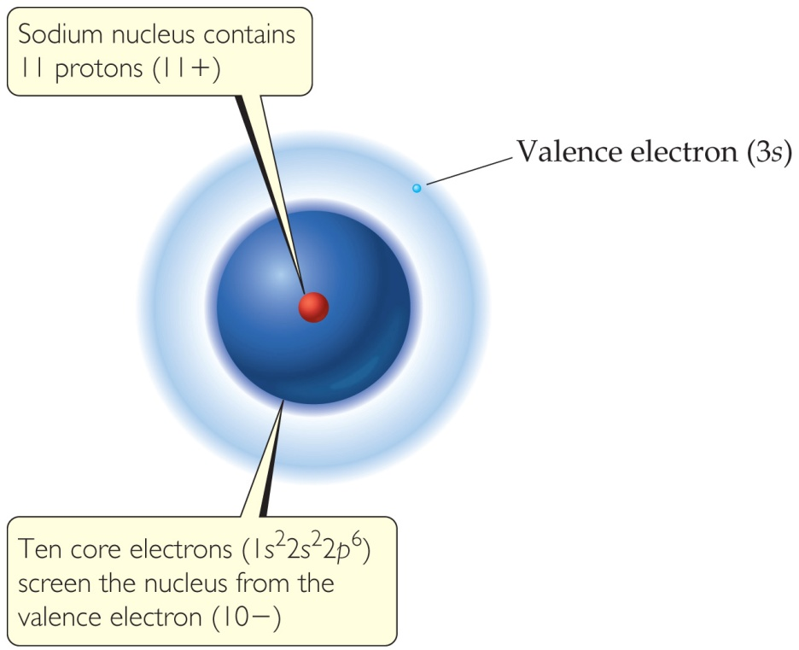
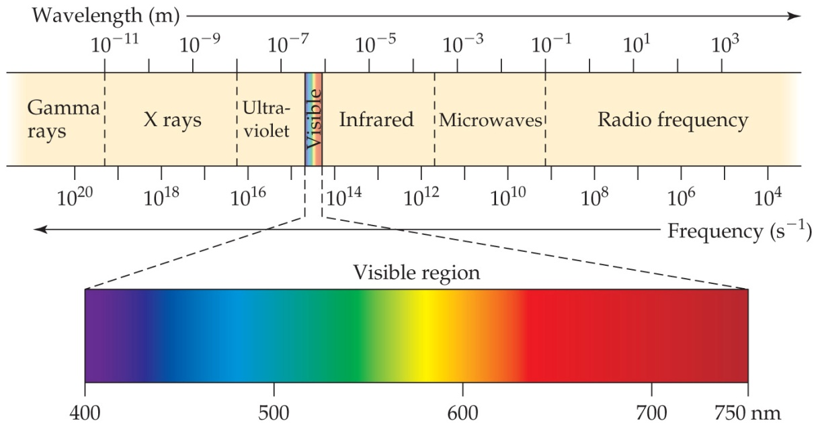
The electronic structure of an atom describes the energies and arrangement of electrons around the atom. Much of what is known about the electronic structure of atoms was obtained by observing the interaction of light with matter.
All electromagnetic radiation travels at the same velocity: The speed of light (c) is 3.00 × 10⁸ m/s.
c = λν; Ε= hν= hc/λ

Slide 4
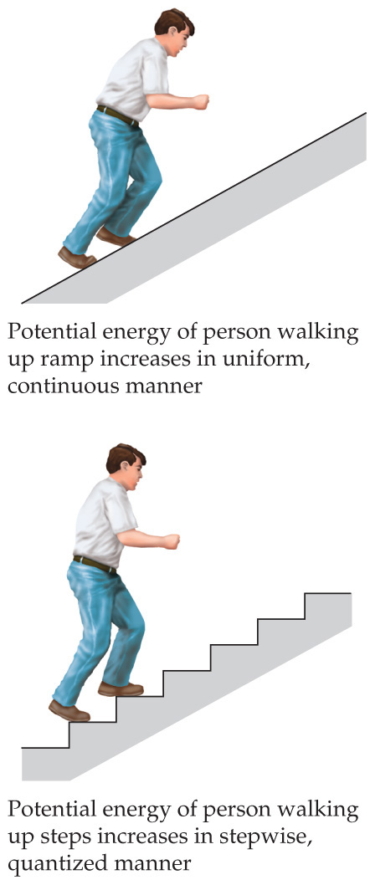
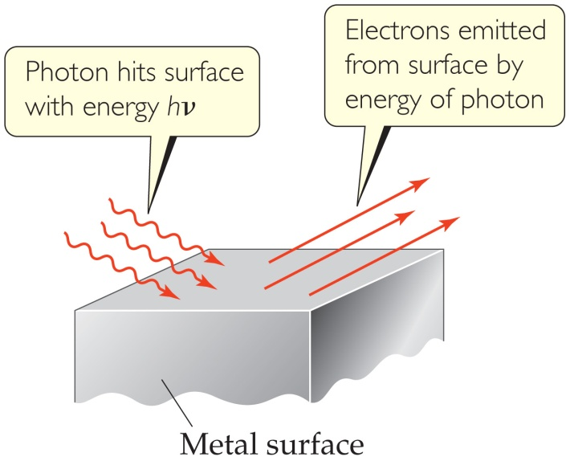
The Nature of Energy—Quanta
Max Planck explained it by assuming that energy comes in packets called quanta (singular: quantum).
He concluded that energy is proportional to frequency:
E = hν
where h is Planck’s constant, 6.626 × 10⁻³⁴ J∙s.

Slide 5
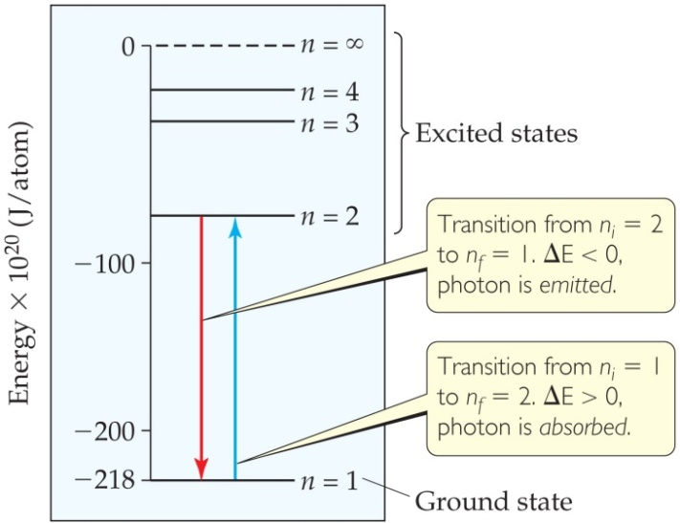

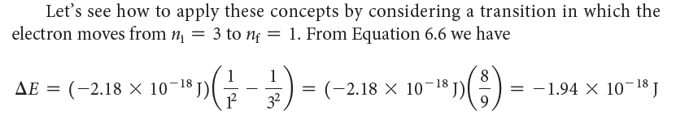
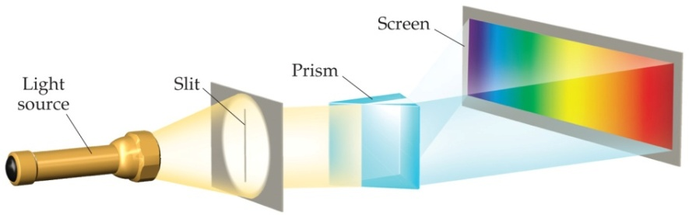
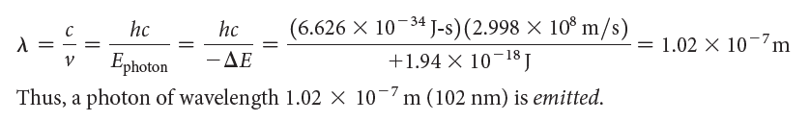
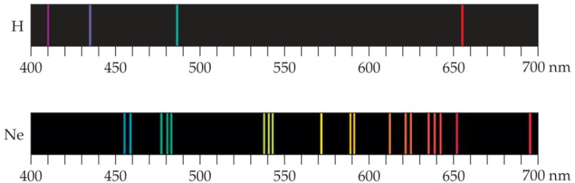

The Bohr Model
Niels Bohr adopted Planck’s assumption and explained these phenomena
(1) Electrons exist only in certain discrete energy levels.
(2) Energy is involved in the transition of an electron from one level to another.
Principal quantum number: n
Ground state
Excited state

Slide 6
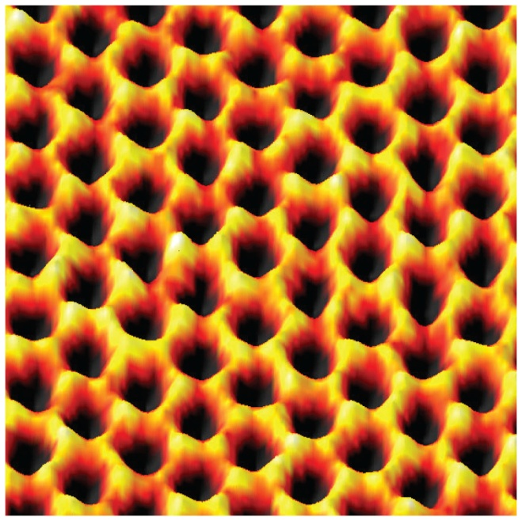
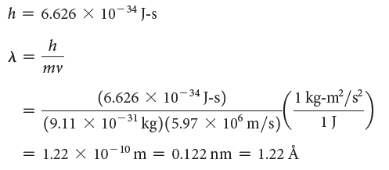
The Wave Nature of Matter
Louis de Broglie theorized that if light can have material properties, matter should exhibit wave properties.
He demonstrated that the relationship between mass and wavelength was
h
mv
λ =

Slide 7
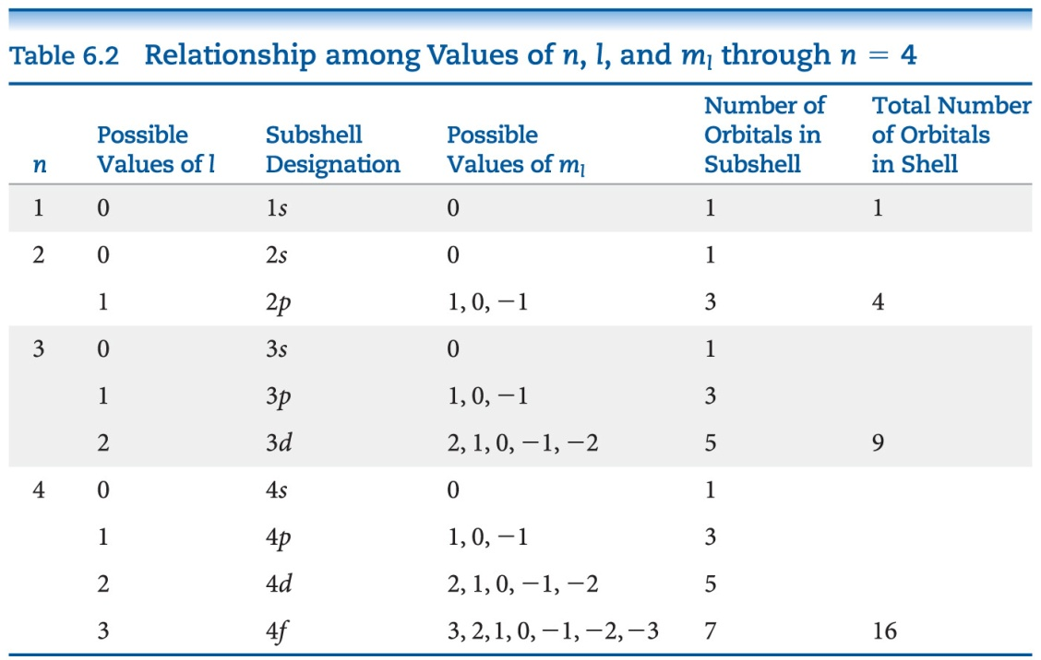
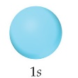
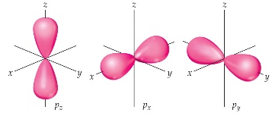
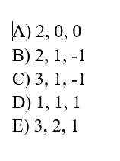
Quantum Number
The solution of Schrödinger’s wave equation is designated with a lowercase Greek psi (ψ).
The square of the wave equation, ψ², gives the electron density, or probability of where an electron is likely to be at any given time.
Principal Quantum Number (n)
Angular Momentum Quantum Number (l)
s,p,d,f
Magnetic Quantum Number (m_{l})
n, l, m_{l}
2e
6e
10e
l: 0 to n − 1
m_{l :} −l ≤ m_{l} ≤ l
s
p
d

Slide 8
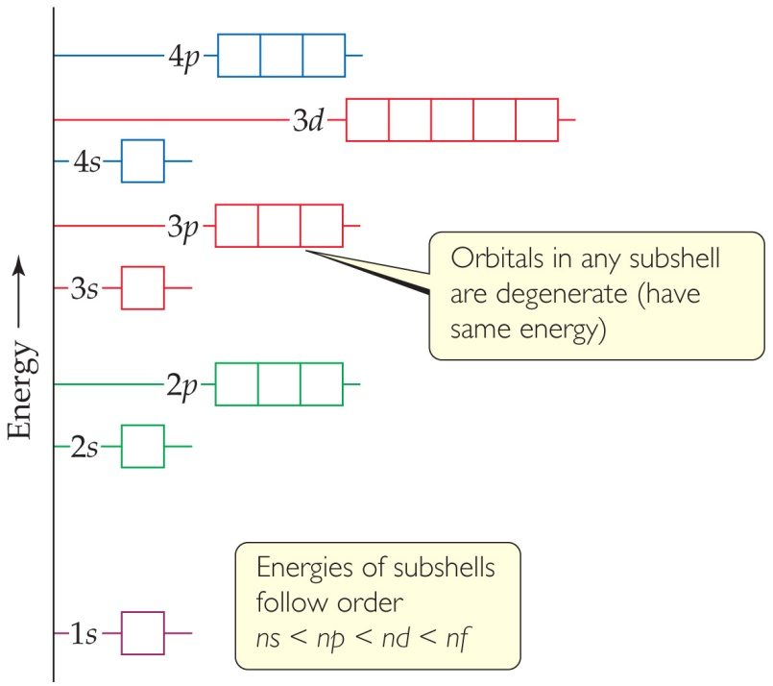
Energies of Orbitals—Many-electron Atoms
As the number of electrons increases, so does the repulsion between them.
Therefore, in atoms with more than one electron, not all orbitals on the same energy level are degenerate.
Orbital sets in the same sublevel are still degenerate.
Energy levels start to overlap in energy (e.g., 4s is lower in energy than 3d.)
Which quantum numbers must be the same for the orbitals that they designate to be degenerate in a multiple-electron system?

Slide 9
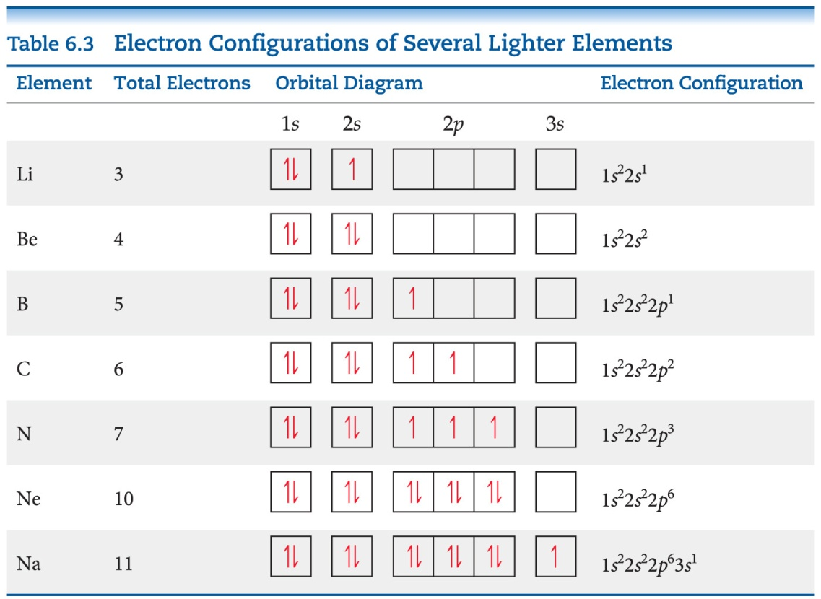


Hund’s Rule
“For degenerate orbitals, the lowest energy is attained when the number of electrons with the same spin is maximized.”
This means that, for a set of orbitals in the same sublevel, there must be one electron in each orbital before pairing and the electrons have the same spin, as much as possible.
C
[He]2s²2p²
[He]2s²2p³
[He]2s²2p⁴
[He]2s²2p⁵
[He]2s²2p⁶
1s²2s²2p⁶3s1
1s²2s²2p⁶3s2
1s²2s²2p⁶3s²3p1
1s²2s²2p⁶3s²3p4
1s²2s²2p⁶3s²3p5
Condensed Electron Configurations
N
F:1s²2s²2p⁵
He:1s²
O
Cl:1s²2s²2p⁶3s²3p⁵
Ne:1s²2s²2p⁶
F
Ne

Slide 10
Lecture Presentation
Chapter 7 Periodic Properties of the Elements
James F. Kirby
Quinnipiac University
Hamden, CT

Slide 11
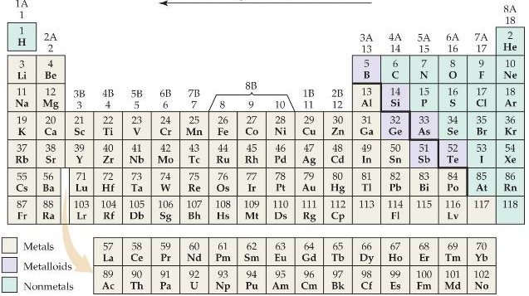
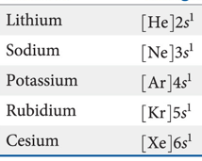
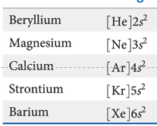
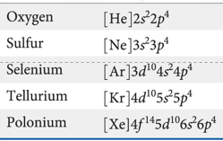
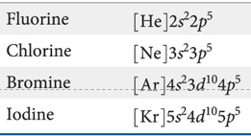
Period, group
1s
n=1
1s 2s2p
n=2
1s 2s2p 3s3p3d
n=3
Down a group
1A
2A
6A
7A

Slide 12
Effective Nuclear Charge
The effective nuclear charge, Z_{eff}, is found this way:
Z_{eff} = Z − S
where Z is the atomic number and S is a screening constant, usually close to the number of inner electrons.
Effective nuclear charge is a periodic property:
It increases across a period.
It increases down a group.
Effective nuclear charge, which is the portion of the nuclear charge that an outer electron experiences after screening by inner electrons.

Slide 13
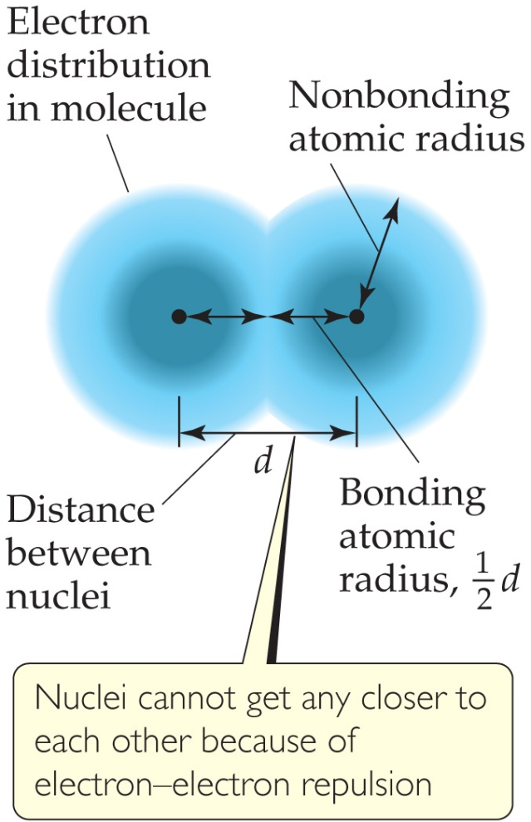
What Is the Size of an Atom?
The nonbonding atomic radius or van der Waals radius is half of the shortest distance separating two nuclei during a collision of atoms.
Bonding atomic radius

Slide 14
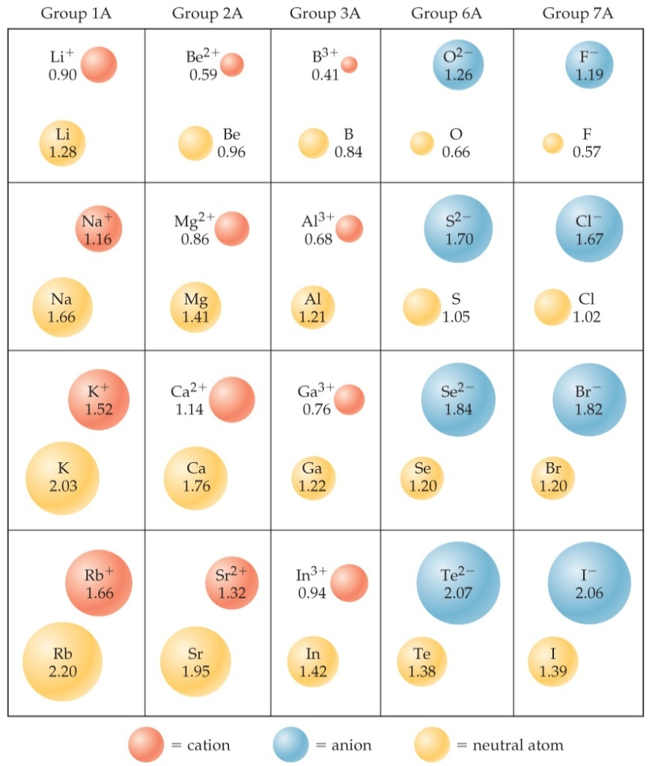
Sizes of Ions
Determined by interatomic distances in ionic compounds
Ionic size depends on
the nuclear charge.
the number of electrons.
the orbitals in which electrons reside.

Slide 15
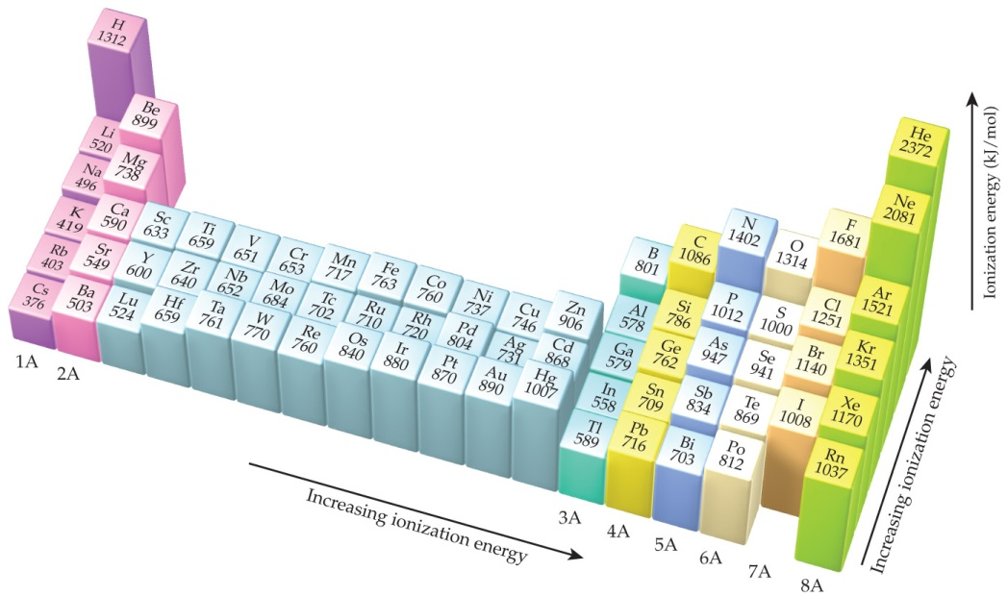
Factors that Influence Ionization Energy
Smaller atoms have higher I values.
I values depend on effective nuclear charge and average distance of the electron from the nucleus.

Slide 16
Electron Configurations of Ions
Cations: The electrons are lost from the highest energy level (n value).
Li⁺ is 1s² (losing a 2s electron).
Fe²⁺ (number 26) is 1s²2s²2p⁶3s²3p⁶3d⁶ (losing two 4s electrons).
Anions: The electron configurations are filled to ns²np⁶; e.g., F– is 1s²2s²2p⁶ (gaining one electron in 2p).

Slide 17
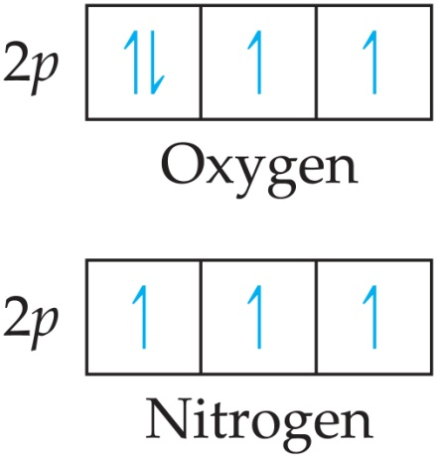
Ionization Energy
It requires more energy to remove each successive electron.
When all valence electrons have been removed, it takes a great deal more energy to remove the next electron.
I₁ generally increases across a period.
I₁ generally decreases down a group.
Smaller atoms have higher I values.
I values depend on effective nuclear charge and average distance of the electron from the nucleus.

Slide 18
Electron Affinity
Electron affinity is the energy change accompanying the addition of an electron to a gaseous atom:
Cl + e⁻ ⎯⎯→ Cl⁻
It is typically exothermic, so, for most elements, it is negative!
△E = -349kJ/mol
EA = -349kJ/mol
A negative electron affinity means that energy is released when the electron is added; hence, when the electron affinity is negative the anion is stable.
By contrast, a positive electron affinity means that the anion is not stable relative to the separated atom and electron, in which case its exact value cannot be measured.

Slide 19
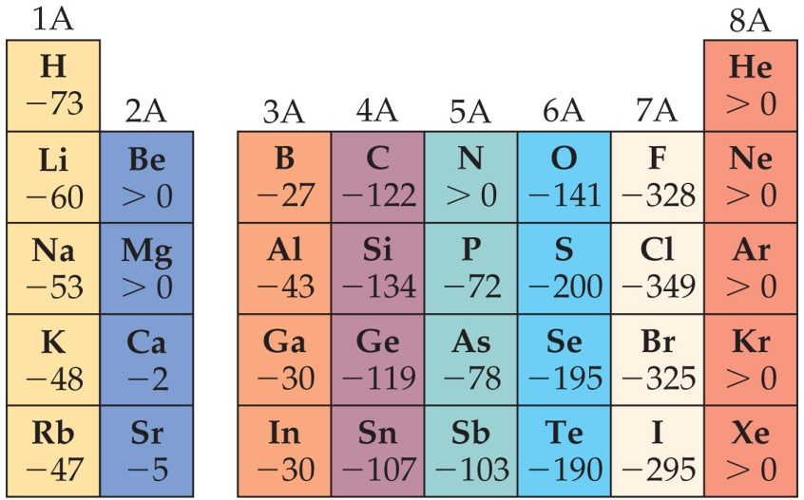
General Trend in Electron Affinity
Not much change in a group.
Across a period, it generally increases. Three notable exceptions include the following:
Group 2A: s sublevel is full!
Group 5A: p sublevel is half-full!
Group 8A: p sublevel is full!
Note: the electron affinity for many of these elements is positive (X– is unstable).

Slide 20
Lecture Presentation
Chapter 8 Basic Concepts of Chemical Bonding
James F. Kirby
Quinnipiac University
Hamden, CT

Slide 21
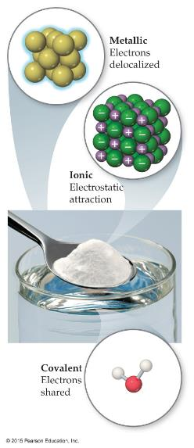
Chemical Bonds
Three basic types of bonds
Ionic
Electrostatic attraction between ions.
Covalent
Sharing of electrons by two atoms.
Metallic
Metal atoms bonded to several other atoms.

Slide 22

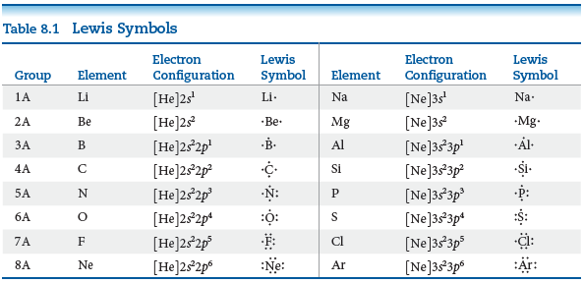
The formation of bonds involves interactions of the outermost electrons of atoms, their valence electrons.
octet rule: Atoms tend to gain, lose, or share electrons until they are surrounded
by eight valence electrons

Slide 23

Ionic Bonding
Atoms tend to lose (metals) or gain (nonmetals) electrons to make them isoelectronic to the noble gases (stable form 2e, 8e, 18e).
The stability of ionic compounds result from the attraction between ions of opposite charge. The strength of the attraction of these interactions is represented by lattice energy.
Lattice energy increases with:
increasing charge on the ions
decreasing size of ions
Q₁Q₂
d
E_{el} = κ

Slide 24
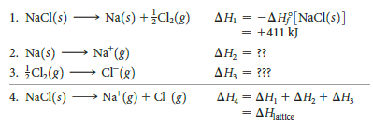


Born-Haber Cycle
2.
3.
Notes:
Decompose/Countereact/offset/disassemble

Slide 25
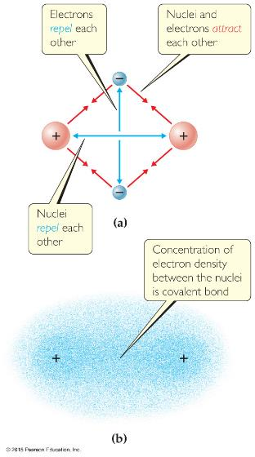
Covalent Bonding
In covalent bonds, atoms share electrons.
There are several electrostatic interactions in these bonds:
attractions between electrons and nuclei,
repulsions between electrons, and
repulsions between nuclei.
For a bond to form, the attractions must be greater than the repulsions.

Slide 26

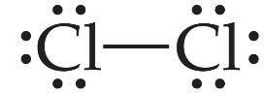
Electrons on Lewis Structures
Lone pairs: electrons located on only one atom in a Lewis structure
Bonding pairs: shared electrons in a Lewis structure; they can be represented by two dots or one line
Notes:
Short line/

Slide 27

Multiple Bonds
Some atoms share only one pair of electrons. These bonds are called single bonds.
Sometimes, two pairs need to be shared. These are called double bonds.
There are even cases where three bonds are shared between two atoms. These are called triple bonds.
Bond length: single bond > double bond > triple bond

Slide 28
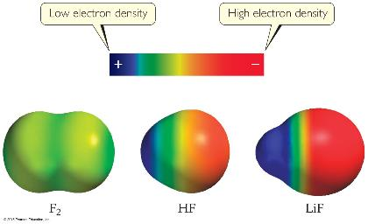
Polar Covalent Bonds
The electrons in a covalent bond are not always shared equally.
Fluorine pulls harder on the electrons it shares with hydrogen than hydrogen does.
Therefore, the fluorine end of the molecule has more electron density than the hydrogen end.

Slide 29
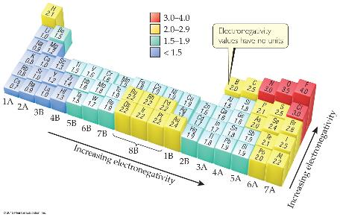
Electronegativity
Electronegativity is the ability of an atom in a molecule to attract electrons to itself.
On the periodic table, electronegativity generally increases as you go
from left to right across a period.
from the bottom to the top of a group.

Slide 30
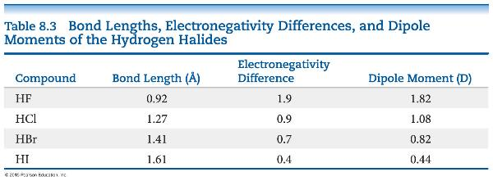
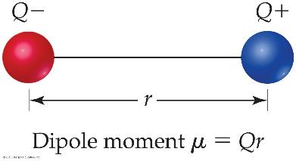
Dipoles
When two equal, but opposite, charges are separated by a distance, a dipole forms.
A dipole moment, μ, produced by two equal but opposite charges separated by a distance, r, is calculated:
μ = Qr
It is measured in debyes (D).

Slide 31
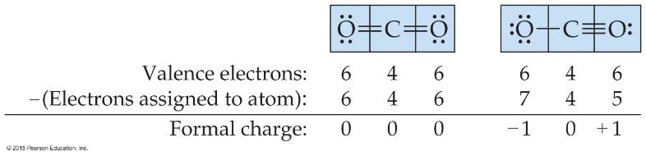
Writing Lewis Structures
Then assign formal charges.
Formal charge is the charge an atom would have if all of the electrons in a covalent bond were shared equally.
Formal charge = valence electrons – ½ (bonding electrons) – all nonbonding electrons

Slide 32
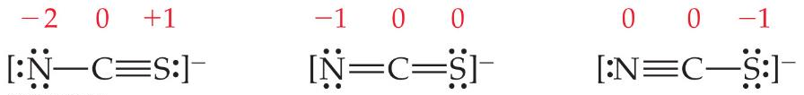
Writing Lewis Structures
The dominant Lewis structure
is the one in which atoms have formal charges closest to zero.
puts a negative formal charge on the most electronegative atom.
Practice excise:
The sulfate ion, SO₄²⁻, can be drawn in many ways. If you minimize formal charge on
The sulfur, how many S=O double bonds should you drawn in the lewis structure
A:0
B:1
C:2
D:3
E:4

Slide 33
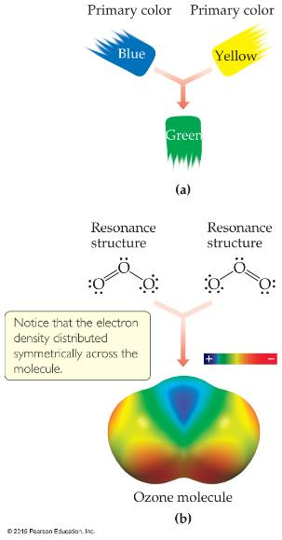
Resonance
One Lewis structure cannot accurately depict a molecule like ozone.
We use multiple structures, resonance structures, to describe the molecule.
Position of electron distribution is different

Slide 34
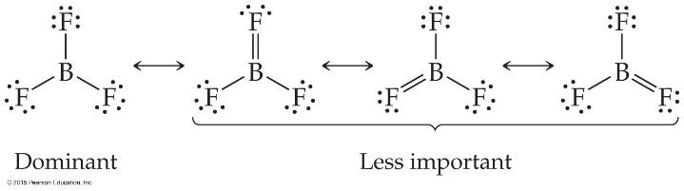
Fewer Than Eight Electrons
Elements in the second period before carbon can make stable compounds with fewer than eight electrons.
Consider BF₃:
Giving boron a filled octet places a negative charge on the boron and a positive charge on fluorine.
This would not be an accurate picture of the distribution of electrons in BF₃.

Slide 35
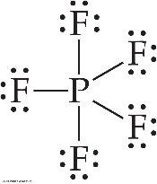
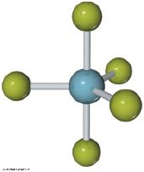
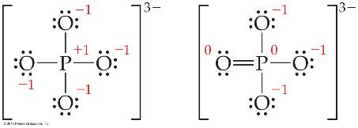
More Than Eight Electrons
When an element is in period 3 or below in the periodic table (e.g., periods 3, 4, 5, etc.), it can use d-orbitals to make more than four bonds.
Examples: PF₅ and phosphate below
(Note: Phosphate will actually have four resonance structures with five bonds on the P atom!)

Slide 36
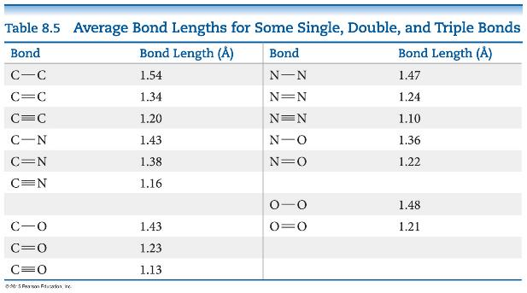
Bond Enthalpy and Bond Length
We can also measure an average bond length for different bond types.
As the number of bonds between two atoms increases, the bond length decreases.

Slide 37
Lecture Presentation
Chapter 9 Molecular Geometry and Bonding Theories

Slide 38
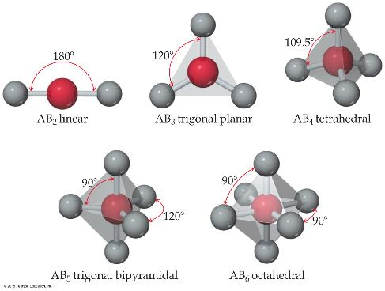
What Determines the Shape of a Molecule?
Simply put, electron pairs, whether they be bonding or nonbonding, repel each other.
By assuming the electron pairs are placed as far as possible from each other, we can predict the shape of the molecule.
This is the Valence-Shell Electron-Pair Repulsion (VSEPR) model.

Slide 39
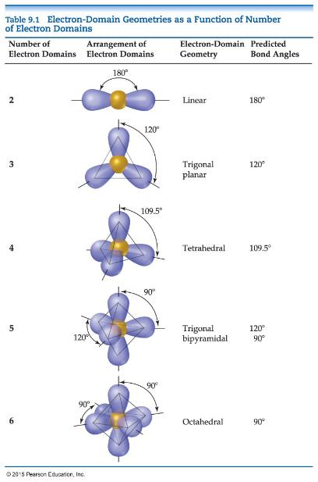
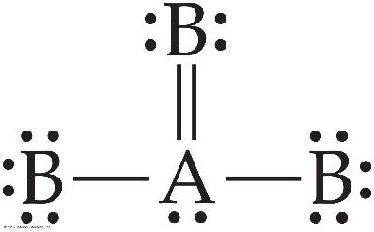
Electron Domains
We can refer to the directions to which electrons point as electron domains. This is true whether there is one or more electron pairs pointing in that direction.
The central atom in this molecule, A, has four electron domains.
The electron domain and molecular geometry of BrO₂⁻ ？

Slide 40
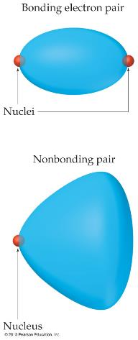
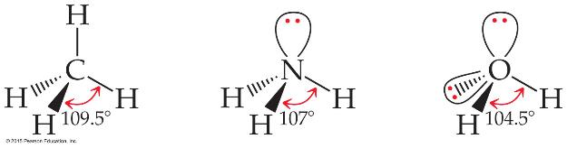
Nonbonding Pairs and Bond Angle
Nonbonding pairs are physically larger than bonding pairs.
Therefore, their repulsions are greater; this tends to compress bond angles.

Slide 41
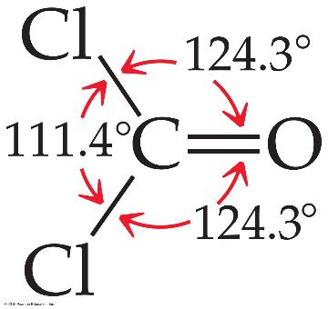
Multiple Bonds and Bond Angles
Double and triple bonds have larger electron domains than single bonds.
They exert a greater repulsive force than single bonds, making their bond angles greater.
PH₃， ClF₃，NCl₃，BCl₃， CO₃²⁻

Slide 42


Shapes of Larger Molecules
For larger molecules, look at the geometry about each atom rather than the molecule as a whole.

Slide 43
Polarity of Molecules
Ask yourself:
COVALENT or IONIC? If COVALENT:
Are the BONDS polar?
NO: The molecule is NONPOLAR!
YES: Continue—Do the AVERAGE position of δ+ and δ– coincide?
YES: The molecule is NONPOLAR.
NO: The molecule is POLAR.
NOTE: Different atoms attached to the central atom have different polarity of bonds.

Slide 44


Comparison of the Polarity of Two Molecules
A NONPOLAR molecule
A POLAR molecule
CCl₄
CH₄
SF₄
SiCl₄

Slide 45

Valence-Bond Theory
In Valence-Bond Theory, electrons of two atoms begin to occupy the same space.
This is called “overlap” of orbitals.
The sharing of space between two electrons of opposite spin results in a covalent bond.
Notes:
Start here 6/14/10

Slide 46
VSEPR and Hybrid Orbitals
VSEPR predicts shapes of molecules very well.
How does that fit with orbitals?
Let’s use H₂O as an example:
If we draw the best Lewis structure to assign VSEPR, it becomes bent.
If we look at oxygen, its electron configuration is 1s²2s²2p⁴. If it shares two electrons to fill its valence shell, they should be in 2p.
Wouldn’t that make the angle 90°?
Why is it 104.5°?

Slide 47




Hybrid Orbitals
Hybrid orbitals form by “mixing” of atomic orbitals to create new orbitals of equal energy, called degenerate orbitals.
When two orbitals “mix” they create two orbitals; when three orbitals mix, they create three orbitals; etc.

Slide 48



sp Orbitals
Carbon: sp³ Hybridization
sp² Hybridization

Slide 49

Sigma (σ) and Pi (π) Bonds
Sigma bonds are characterized by
head-to-head overlap.
cylindrical symmetry of electron density about the internuclear axis.
Pi bonds are characterized by
side-to-side overlap.
electron density above and below the internuclear axis.

Slide 50


Bonding in Molecules
Single bonds are always σ-bonds.
Multiple bonds have one σ-bond, all other bonds are π-bonds.

Slide 51
Molecular Orbital (MO) Theory
Wave properties are used to describe the energy of the electrons in a molecule.
Molecular orbitals have many characteristics like atomic orbitals:
maximum of two electrons per orbital
Electrons in the same orbital have opposite spin.
Definite energy of orbital
Can visualize electron density by a contour diagram

Slide 52
More on MO Theory
They differ from atomic orbitals because they represent the entire molecule, not a single atom.
Whenever two atomic orbitals overlap, two molecular orbitals are formed: one bonding, one antibonding.
Bonding orbitals are constructive combinations of atomic orbitals.
Antibonding orbitals are destructive combinations of atomic orbitals. They have a new feature unseen before: A nodal plane occurs where electron density equals zero.

Slide 53

Molecular Orbital (MO) Theory
Whenever there is direct overlap of orbitals, forming a bonding and an antibonding orbital, they are called sigma (σ) molecular orbitals. The antibonding orbital is distinguished with an asterisk as σ*. Here is an example for the formation of a hydrogen molecule from two atoms.
Notes:
Start here 6/16/10

Slide 54

MO Diagram
An energy-level diagram, or MO diagram shows how orbitals from atoms combine to give the molecule.
In H₂ the two electrons go into the bonding molecular orbital (lower in energy).
Bond order = ½(# of bonding electrons – # of antibonding electrons) = ½(2 – 0) = 1 bond

Slide 55
Can He₂ Form? Use MO Diagram and Bond Order to Decide!
Bond Order = ½(2 – 2) = 0 bonds
Therefore, He₂ does not exist.
How about He₂⁺ ?

Slide 56

s and p Orbitals Can Interact
For atoms with both s and p orbitals, there are two types of interactions:
The s and the p orbitals that face each other overlap in σ fashion.
The other two sets of p orbitals overlap in π fashion.
These are, again, direct and “side-ways” overlap of orbitals.

Slide 57

MO Theory
The resulting MO diagram:
There are σ and σ* orbitals from s and p atomic orbitals.
There are π and π* orbitals from p atomic orbitals.
Since direct overlap is stronger, the effect of raising and lowering energy is greater for σ and σ*.

Slide 58

s and p Orbital Interactions
In some cases, s orbitals can interact wit the p_{z} orbitals more than the p_{x} and p_{y} orbitals.
It raises the energy of the p_{z} orbital and lowers the energy of the s orbital.
The p_{x} and p_{y} orbitals are degenerate orbitals.

Slide 59

MO Diagrams for Diatomic Molecules of 2nd Period Elements

Slide 60
MO Diagrams and Magnetism
Diamagnetism is the result of all electrons in every orbital being spin paired. These substances are weakly repelled by a magnetic field.
Paramagnetism is the result of the presence of one or more unpaired electrons in an orbital.
Is oxygen (O₂) paramagnetic or diamagnetic? Look back at the MO diagram! It is paramagnetic.

Slide 61

Paramagnetism of Oxygen
Lewis structures would not predict that O₂ is paramagnetic.
The MO diagram clearly shows that O₂ is paramagnetic.
Both show a double bond (bond order = 2).

Slide 62

Heteronuclear Diatomic Molecules
Diatomic molecules can consist of atoms from different elements.
How does a MO diagram reflect differences?
The atomic orbitals have different energy, so the interactions change slightly.
The more electronegative atom has orbitals lower in energy, so the bonding orbitals will more resemble them in energy.

